Slide 1
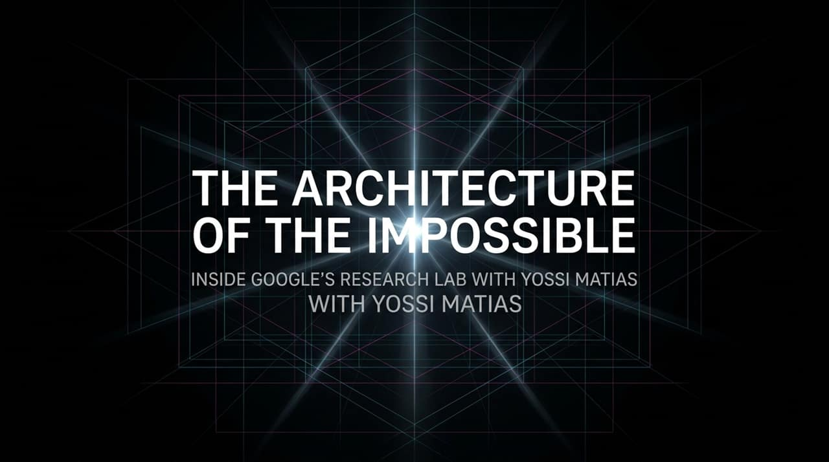
Notes:
Welcome, everyone. Today, we are taking a deep dive inside Google Research to explore how we transition technologies from the realm of the seemingly "impossible" into the foundation of everyday life.
When Google was founded, it started with a single research paper. Today, Google Research operates on a vast spectrum—from the microscopic level of the cell up to planetary-scale modeling, and from foundational machine learning algorithms all the way to quantum computing. We are the team behind breakthroughs like the Transformer architecture—the paper Attention Is All You Need, which sparked the generative AI revolution—as well as early conversational AI like Google Duplex, global flood warning systems, and quantum processors.
We find ourselves in what can truly be described as the "Golden Age of Research." Never before have scientists and engineers had the ability to imagine a future and then bring it into reality with the speed and global scope that we can achieve today.
Throughout this presentation, we will discuss how AI is evolving from a discrete tool into a continuous background utility—what we call Ambient Intelligence. We will look at how AI is accelerating the scientific method itself, turning researchers into polymaths, and how quantum computing will bridge with neural networks to solve humanity’s most complex challenges. Let's begin.
https://www.youtube.com/watch?v=ggPWZ34gGaY

Slide 2
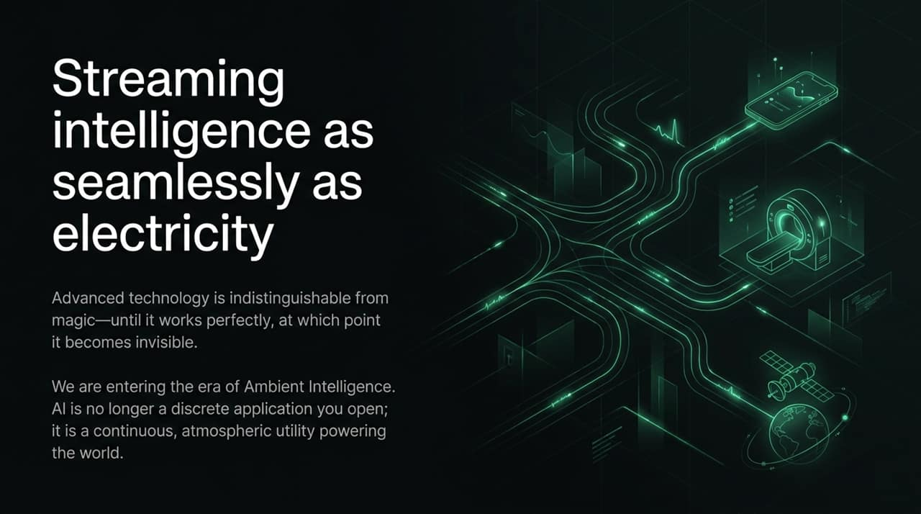
Notes:
Arthur C. Clarke famously stated that "Any sufficiently advanced technology is indistinguishable from magic." But as Yossi Matias points out, there is a second half to that truth: once a technology works reliably and continuously, it ceases to feel like magic—it becomes invisible.
Think about how we interact with technology today. A decade ago, typing a question into a search engine and receiving instant answers felt miraculous. Today, "Googling it" is second nature. Similarly, when you plug your smartphone into a wall outlet, you don't ponder the grid or the physics of alternating current—you simply assume the power is there.
We are now entering the era of Ambient Intelligence. AI is undergoing a fundamental paradigm shift. It is no longer a discrete application or a destination tool that you consciously open on a screen. Instead, it is becoming a continuous, atmospheric layer running in the background—streaming intelligence just like electricity or water.
When intelligence becomes ambient, the barrier to asking complex questions vanishes. Users no longer need to figure out how to query a system or format their intent; the ambient layer understands context, anticipates needs, and delivers answers seamlessly across devices and modalities. As we elevate this baseline, intelligence is taken for granted, allowing humanity to focus on the next set of higher-level challenges.

Slide 3
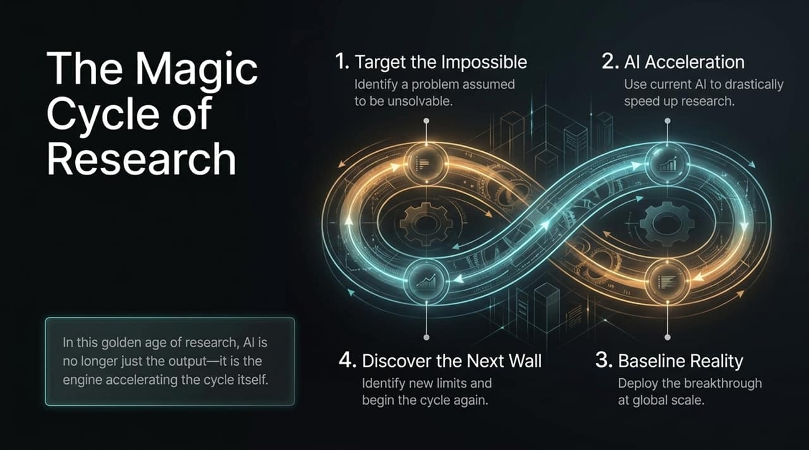
Notes:
How do we systematically build this ambient future? At Google Research, we drive progress through what we call "The Magic Cycle of Research." This is a continuous, four-stage feedback loop that powers all of our breakthroughs.
Target the Impossible: We begin by identifying a high-impact problem in society, healthcare, or computing that is widely assumed to be unsolvable due to data limitations or human bandwidth constraints.
AI Acceleration: We leverage our current best AI models and algorithmic innovations to drastically speed up research and experimentation.
Baseline Reality: Once we achieve a research breakthrough, we don't leave it in the lab. We deploy it into production across our platforms to make it a global "baseline reality" for billions of people.
Discover the Next Wall: The moment a breakthrough becomes the new baseline, it exposes new limits, open questions, and higher-level challenges. We hit the next wall, refine our questions, and begin the cycle again.
What makes this present moment a "golden age" is that AI is no longer just the output of the cycle—it has become the engine accelerating the cycle itself. We are using AI to build better AI, optimize hardware, write software, and formulate scientific hypotheses. As this recursive loop tightens, the time required to move from an "impossible" concept to a scaled reality shrinks from decades to years, and from years to days.

Slide 4
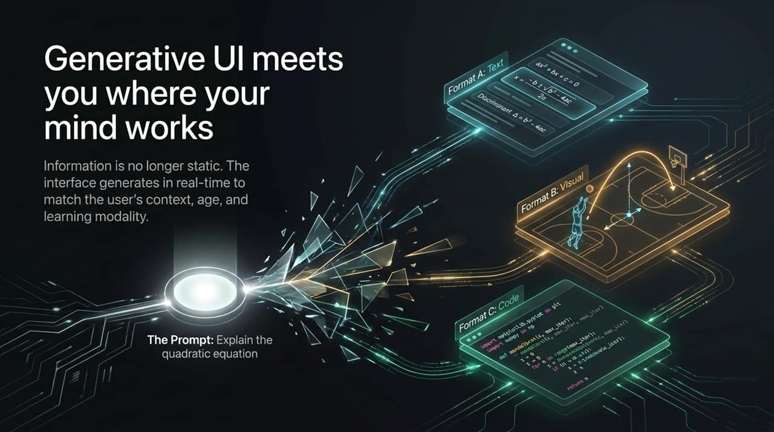
Notes:
One of the key manifestations of Ambient Intelligence in user experience is Generative UI (GenUI). Historically, digital interfaces have been static. Software designers built fixed layouts, and every user, regardless of their background, age, or learning style, saw the exact same screen.
Generative UI turns this paradigm on its head. Information is no longer static; the interface itself is generated dynamically in real-time to match the user's explicit prompt, implicit context, device, and personal learning modality.
Look at the example on this slide for the prompt "Explain the quadratic equation."
For a student who prefers abstract mathematical notation, GenUI renders Format A: pure algebraic equations and discriminant formulas.
For a visual learner or a younger child, GenUI creates Format B: a dynamic visual graphic showing a basketball player shooting hoops, illustrating how the arc of the ball directly represents a parabolic curve and quadratic parameters.
For a computer science student or software developer, GenUI generates Format C: executable Python code using libraries like NumPy and Matplotlib to render Mandelbrot fractals or quadratic curves.
GenUI allows software to meet your mind where it naturally works. Whether you are an expert needing dense menu text or a visual thinker needing diagrams, ambient AI adapts the interface presentation on the fly.

Slide 5
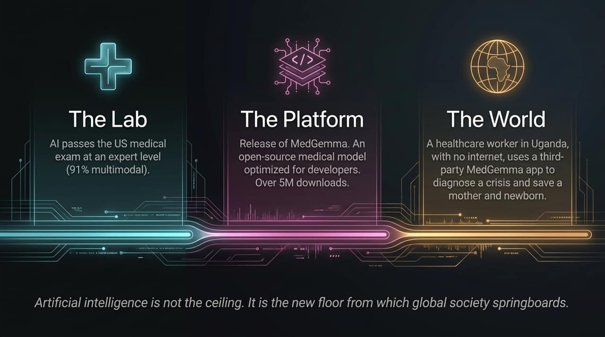
Notes:
To see the Magic Cycle of Research in action, let's examine our work in healthcare. We view AI not as a ceiling that caps achievement, but as a brand-new floor from which global society springboards.
Look at the progression across these three pillars:
The Lab: A few years ago, we set a benchmark challenge: Could an AI model pass the US Medical Licensing Examination (USMLE)? We started by achieving a passing score, and rapidly progressed to expert-level performance—reaching over 91% accuracy across multimodal medical inputs (text, images, clinical data).
The Platform: Benchmarks in a lab mean nothing if developers can't access the tech. We translated those research insights into MedGemma, an open-source medical model optimized for developers worldwide. MedGemma has already surpassed 5 million downloads, enabling startups and researchers to bypass years of foundational model training.
The World: The true test of research is its real-world impact. Recently, a healthcare worker in rural Uganda was facing a critical maternal emergency with no internet access. Using a third-party mobile app powered offline by MedGemma, she received instant clinical advice on handling the complication—saving the lives of both the mother and her newborn.
This is what happens when advanced research becomes open infrastructure. By raising the technology floor, a local health worker in a remote clinic gains the diagnostic leverage of an expert medical panel.

Slide 6
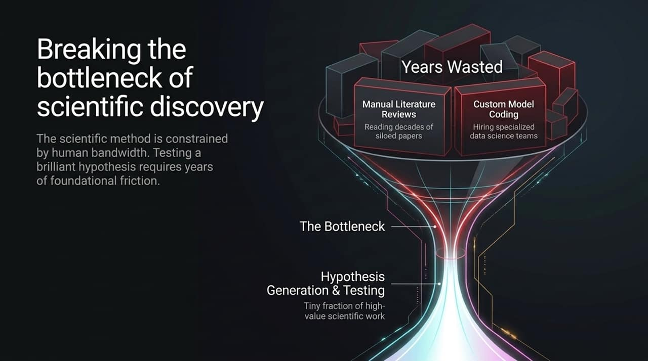
Notes:
While AI is transforming healthcare and software, its most profound impact will be on the scientific method itself.
For centuries, scientific progress has been heavily constrained by human bandwidth. When a brilliant researcher formulates a breakthrough hypothesis, they immediately encounter massive foundational friction.
Look at where a scientist's time is traditionally wasted:
Manual Literature Reviews: Researchers spend months or years reading thousands of siloed papers published across physics, chemistry, and biology just to understand what has already been tried or disproven.
Custom Model Coding: If a chemist or biologist wants to test a digital hypothesis, they often must pause their science to spend weeks writing complex empirical models or hiring specialized data science teams.
As a result, Hypothesis Generation & Testing—the actual high-value, creative heart of science—occupies only a tiny fraction of a researcher's time. The rest is consumed by administrative and mechanical overhead.
If we are to solve pressing global challenges like antibiotic resistance, climate change, and clean energy, we cannot afford to let scientific bandwidth remain bottlenecked by manual processing. We need tools that remove this mechanical friction.

Slide 7
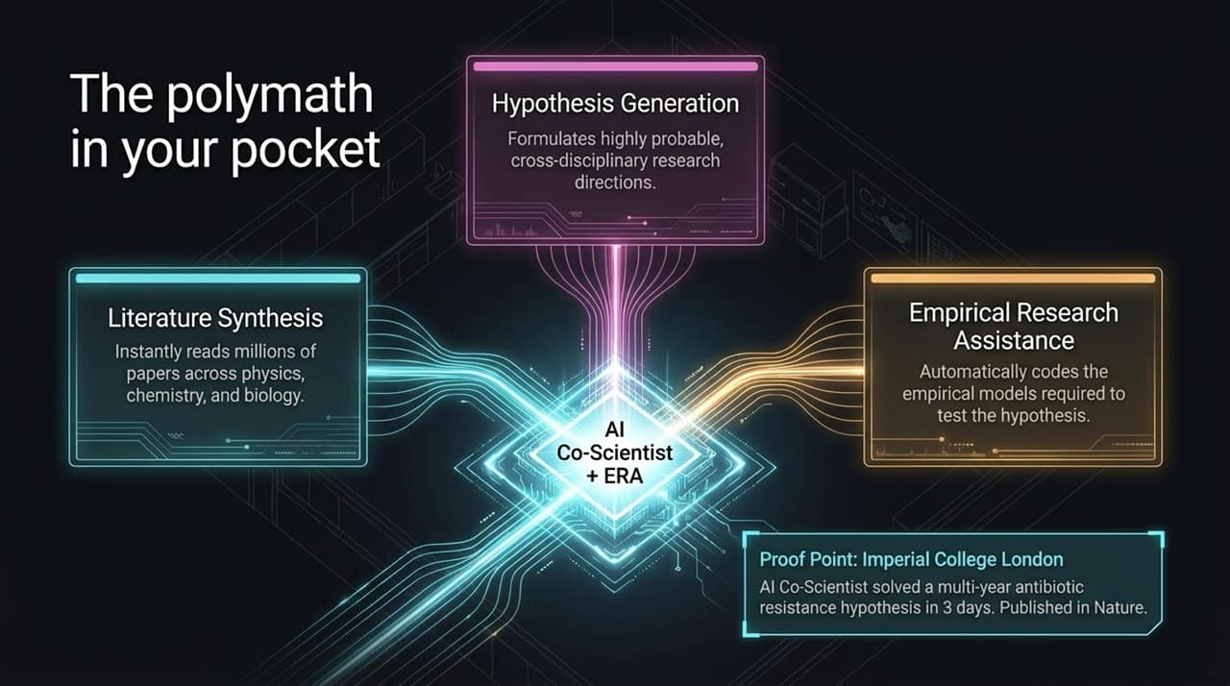
Notes:
To eliminate these scientific bottlenecks, Google Research developed two complementary agentic systems: AI Co-Scientist and the Empirical Research Assistant (ERA).
AI Co-Scientist acts as a multi-agent polymath. It performs:
Literature Synthesis: It reads through millions of papers across physics, chemistry, biology, and medicine simultaneously, connecting disparate facts that no single human could ever hold in their head.
Hypothesis Generation: It formulates highly probable, cross-disciplinary research hypotheses and rigorously ranks them based on existing literature and experimental data.
Meanwhile, the Empirical Research Assistant automatically handles the technical implementation—coding the empirical models needed to test those hypotheses in a virtual lab environment.
The Proof Point: Consider our work with partners at Imperial College London. They had spent years studying why certain bacteria become resistant to antibiotics. When configured with the problem, AI Co-Scientist analyzed the domain literature and generated the exact, multi-year antibiotic resistance hypothesis in just 3 days. The resulting research was validated and recently published in Nature.

Slide 8
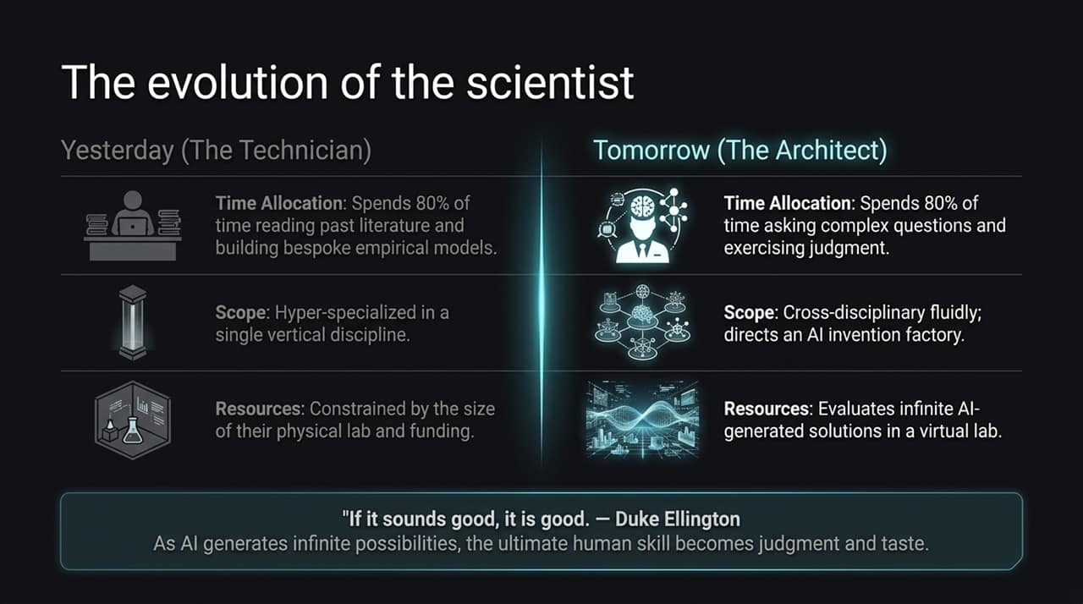
Notes:
The shift in scientific tools necessitates a fundamental shift in the human role. We are witnessing the evolution of the scientist from a technician to an architect.
Yesterday (The Technician): A scientist spent 80% of their time performing repetitive manual work—reading past literature, synthesizing citations, and building bespoke empirical models. Their scope was strictly hyper-specialized within a single vertical discipline, and their productivity was bounded by physical lab space, grant funding, and human hours.
Tomorrow (The Architect): The scientist spends 80% of their time asking complex, visionary questions, defining problems, and exercising high-level judgment. Their scope is cross-disciplinary and fluid; they direct an AI-powered "invention factory" that can evaluate thousands of candidate solutions in parallel.
I love to reference Duke Ellington’s famous quote on music: "If it sounds good, it is good."
As AI tools generate an infinite stream of hypotheses, code, and molecular candidates, the bottleneck shifts away from execution. The ultimate human skill becomes judgment, taste, and discernment. Human researchers provide the steering, empathy, and critical evaluation to determine which solutions truly matter for humanity.

Slide 9
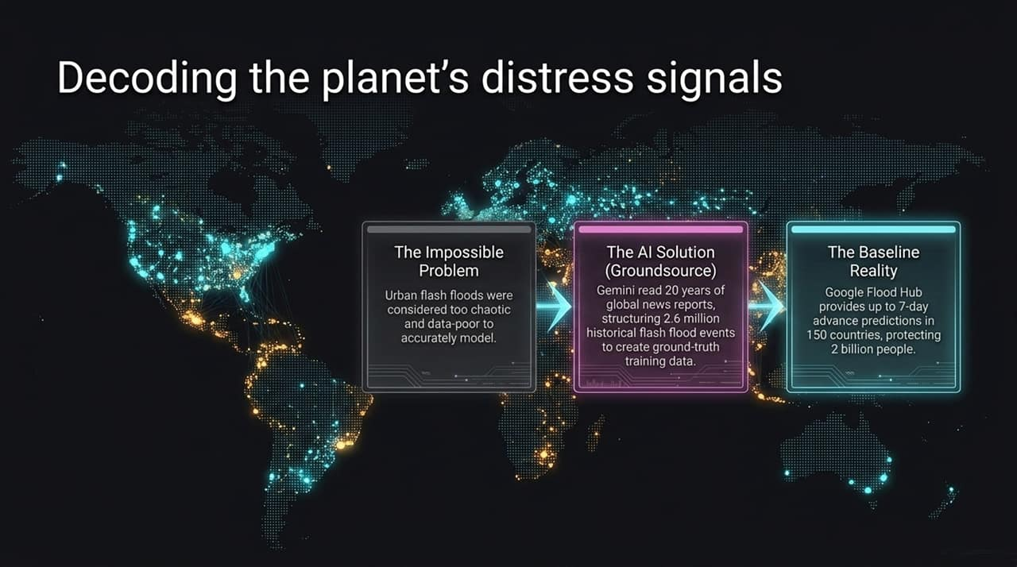
Notes:
Let's look at how the Magic Cycle of Research addresses climate and planetary resilience through Google Flood Hub.
The Impossible Problem: For decades, urban flash floods were considered too chaotic, localized, and data-poor to accurately model or predict. Hydrologists believed reliable global early warnings were mathematically out of reach.
The AI Solution (Groundsource): To overcome the lack of physical sensor data in vulnerable regions, our researchers realized that news outlets have reported on local flood events for decades. We deployed Gemini to read 20 years of global news reports across dozens of languages, extracting and structuring 2.6 million historical flash flood events to build an unprecedented ground-truth training dataset.
The Baseline Reality: Today, Google Flood Hub provides up to 7-day advance flood predictions across 150 countries, protecting over 2 billion people.
Think about what a 7-day warning means. In places like Nigeria, governments and NGOs use our Flood Hub API to automatically distribute cash transfers to villagers before the waters arrive, allowing families to evacuate safely with their belongings. What was deemed impossible eight years ago is now an operational, life-saving infrastructure.

Slide 10
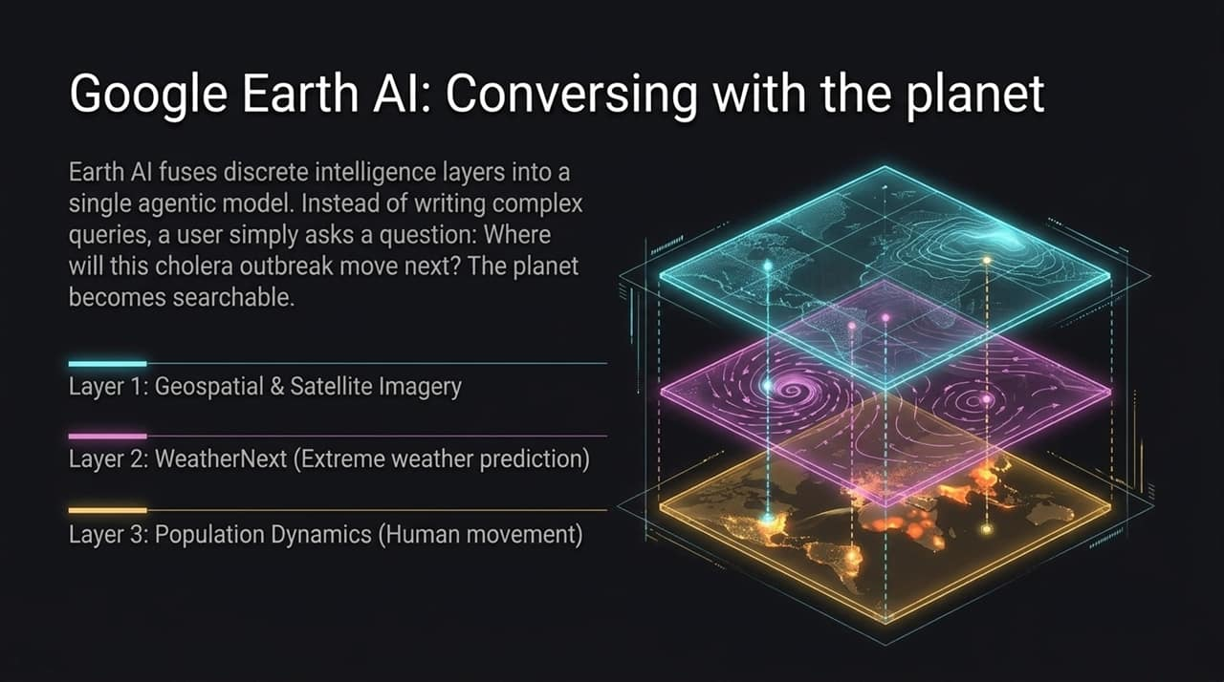
Notes:
Building on flood forecasting, we asked: What if we didn't just solve one natural disaster model at a time? What if we unified all planetary data into a single, conversational interface?
This is Google Earth AI—a platform for planetary intelligence. Earth AI fuses multiple complex, discrete intelligence layers into a single agentic model:
Layer 1: Geospatial & Satellite Imagery: High-resolution optical, radar, and land-use mapping.
Layer 2: WeatherNext: DeepMind's extreme weather and atmospheric prediction models.
Layer 3: Population Dynamics: Privacy-preserving foundation models tracking human movement and urbanization trends.
Instead of writing complex GIS code or querying fragmented climate databases, users can simply converse with the planet in plain natural language.
An epidemiologist can ask: "Where will this cholera outbreak spread next given current rainfall and population movement?" An urban planner can ask: "If we build a highway through this county, which forest corridor is most critical to protect endangered biodiversity?" Earth AI transforms the Earth into a searchable, interactive, and understandable system.

Slide 11
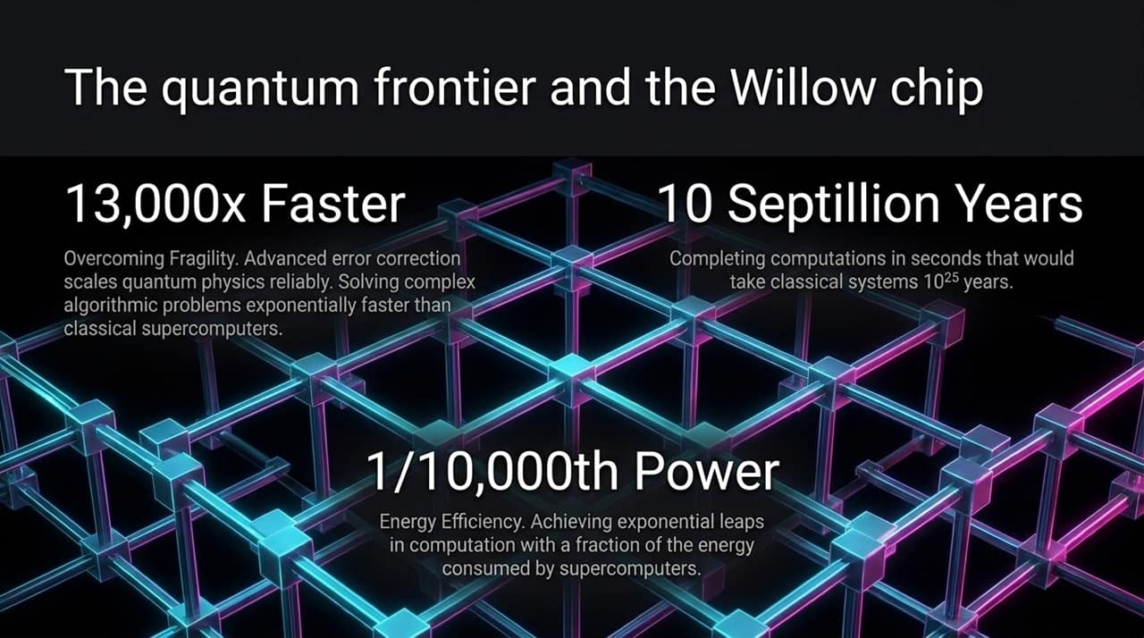
Notes:
While ambient AI transforms software and scientific workflows, solving nature's deepest computational bottlenecks requires entering the quantum frontier.
Quantum computing operates on a fundamentally different paradigm than classical supercomputers. Classical bits are strictly 0 or 1, whereas quantum qubits leverage superposition and entanglement. However, qubits are notoriously fragile and prone to environmental noise.
With our breakthrough Willow quantum chip, Google achieved a historic milestone in quantum error correction: as we added more physical qubits to scale the system, the error rate actually decreased.
Look at the metrics achieved by Willow:
10 Septillion Years: On standard benchmarks, Willow completed a complex computation in seconds that would take the world’s fastest classical supercomputer ${10}^{25}$years (10 septillion years)—a duration vastly longer than the age of the universe.
13,000x Faster Verified Advantage: On verified benchmarks like the Echo algorithm, Willow demonstrated exponential performance scaling over classical algorithms.
1/10,000th Power Consumption: Willow achieves these exponential computational leaps consuming a tiny fraction of the electrical energy required by traditional supercomputer clusters.
Quantum is no longer a distant theoretical concept; it is rapidly progressing toward practical, real-world utility.

Slide 12
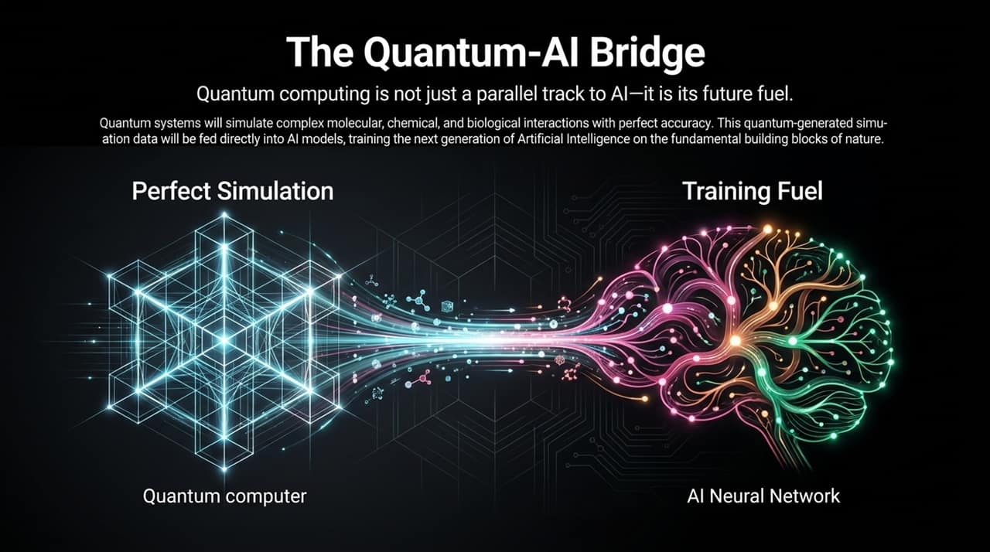
Notes:
It is critical to realize that Quantum Computing and Artificial Intelligence are not competing or parallel technologies. Rather, Quantum is the ultimate future fuel for AI.
Today's neural networks are heavily constrained by the training data available. When we try to model complex chemistry, battery materials, or protein interactions, classical computers must rely on approximations because simulating exact quantum mechanical physics at the atomic level is classically intractable.
Here is how the Quantum-AI Bridge functions:
Perfect Simulation: Quantum computers naturally excel at simulating nature because nature itself operates on quantum physics. Willow-class systems will simulate complex molecular, chemical, and biological interactions with exact physical fidelity.
Training Fuel: The flawless physical data generated by quantum simulations will be fed directly into AI neural networks as synthetic training data.
Advanced Intelligence: AI models trained on exact quantum data will develop a fundamental understanding of nature's building blocks, accelerating drug discovery, material design, and high-temperature superconductors.
Quantum solves the physical data bottleneck, providing the pure training ground for the next generation of artificial intelligence.

Slide 13
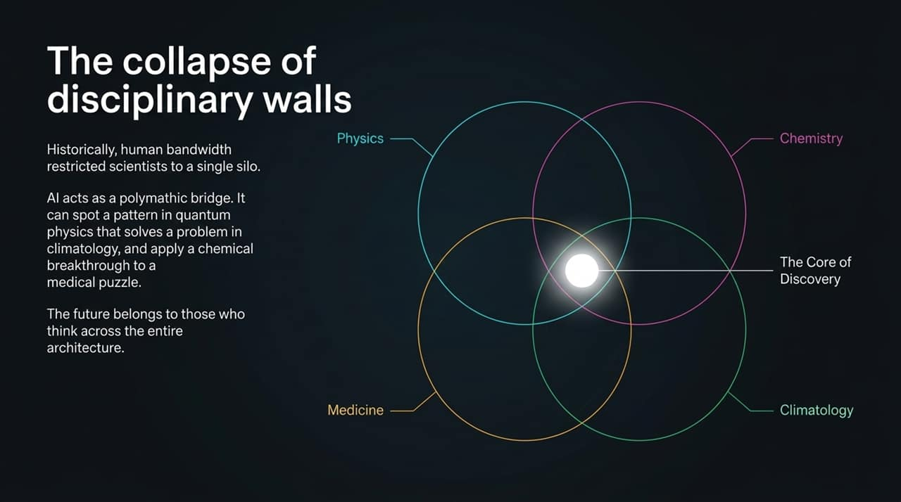
Notes:
For centuries, academic institutions have organized human knowledge into strict vertical silos: Physics, Chemistry, Medicine, and Climatology. This was necessary because human cognitive bandwidth prevented any individual from mastering more than one discipline.
However, nature does not operate in silos. The physical mechanics of a protein folding involve physics, chemistry, biology, and thermodynamics simultaneously.
AI acts as a polymathic bridge that collapses these disciplinary walls:
An AI co-scientist can spot a mathematical pattern in quantum physics data and immediately apply it to solve a carbon-capture problem in climatology.
It can take a structural breakthrough in chemistry and map it directly onto a receptor target in medicine.
The core of discovery sits at the bright intersection where these four domains overlap. The future of research does not belong to those who stay comfortably inside a single domain, but to those who think across the entire architecture of science.

Slide 14
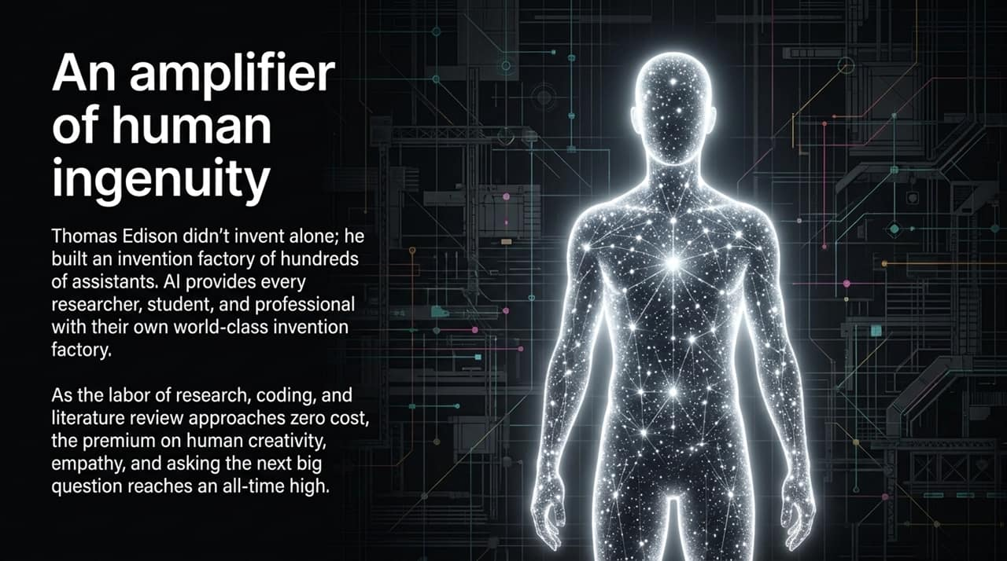
Notes:
When people evaluate AI, they often worry that automating basic tasks will make human workers redundant. In research, the opposite is true: AI is an amplifier of human ingenuity.
Consider Thomas Edison. History remembers Edison as a lone genius inventor, but in reality, he built the world's first modern research park in Menlo Park, NJ, employing over 100 skilled technicians, machinists, and assistants—his "invention factory." Top scientists today similarly manage large university labs.
AI democratizes the invention factory. It grants every individual student, independent developer, doctor, and veteran researcher their own virtual lab staff.
As the mechanical labor of literature synthesis, data cleaning, and boilerplate coding approaches zero cost, the premium on uniquely human qualities—creativity, empathy, critical judgment, and asking the right questions—reaches an all-time high. AI expands human potential rather than replacing it.

Slide 15
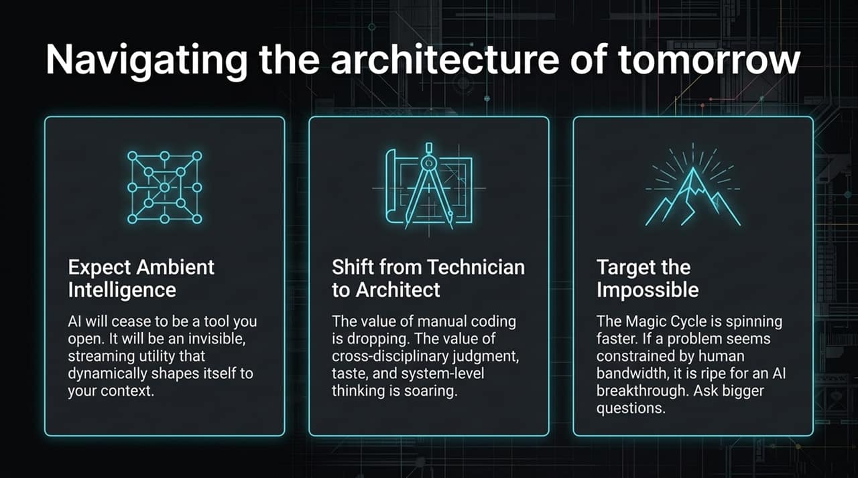
Notes:
To synthesize what we have discussed today, navigating the architecture of tomorrow requires embracing three key strategic posture shifts:
Expect Ambient Intelligence: Stop designing software as static, isolated applications. Prepare for a world of continuous, context-aware intelligence that dynamically generates its own interfaces to meet user intent.
Shift from Technician to Architect: The market value of manual coding and routine data collection is plummeting. The value of systems-level thinking, cross-disciplinary judgment, domain taste, and ethical oversight is soaring.
Target the Impossible: The Magic Cycle of Research is spinning faster than ever. If a problem in your industry currently seems intractable due to human bandwidth or data complexity, it is prime for an AI breakthrough. Ask bigger questions.

Slide 16
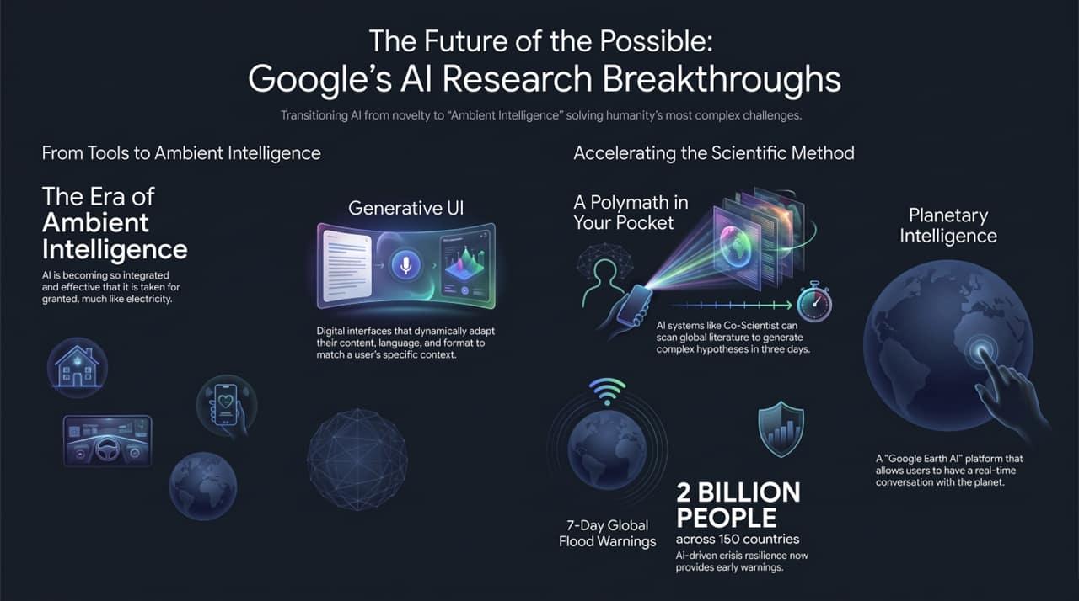
Notes:
To conclude, Google Research is committed to transitioning AI from a technical novelty into an Ambient Intelligence that solves humanity's most complex challenges.
Look at what is already becoming our new baseline:
Generative UI dynamically tailoring information to individual human context.
AI Co-Scientists compressing years of literature review and hypothesis testing into three days.
Planetary Intelligence protecting 2 billion people across 150 countries with 7-day early flood warnings.
Open Platforms like MedGemma democratizing clinical AI to save lives in remote corners of the world.
Artificial Intelligence is not the end of human discovery—it is the springboard. By architecting the impossible today, we build the baseline reality for tomorrow. Thank you.
https://www.youtube.com/watch?v=ggPWZ34gGaY

